Slide 1
IT1212 System Analysis & Design
System Design

Slide 2
Draw notation to the followings
Entity
Attribute
Relationship
Key Attribute
Multivalued attributes
Derived Attribute
Weak Entity
Identifying Relationship

Slide 3
Conceptual Design
Notations
Entity
Relationship
Attribute

Slide 4
Conceptual Design
Attribute
Key Attribute
Multivalued attributes
Derived Attribute
Weak Entity
Identifying Relationship

Slide 5
Explain the term ‘Degree’
Number of participating entity types.
Unary Relationship
A relationship between the instances of a single entity type
e.g. Person is married to a Person
Employee manages Employees
Binary Relationship
A relationship between the instances of two entity types
e.g. An employee works for a department
manages
Employee
Works-for
Department
Employee

Slide 6
Degree of Relationship Type
Ternary Relationship
A simultaneous relationship among the instances of three entity types
Supplier s supplies part p to project j
Part
Supplier
Supplies
Project

Slide 7
Explain term ‘Cardinality’
Cardinality Ratios for Binary Relationships
Specify the number of instances of one entity that can (or must) be associated with each instance of another entity.
The possible cardinality ratios for binary relationship types are
1:1
1:N
M:N

Slide 8
Entity Types
Strong (Regular) Entity
An entity that exists independently of other entity types
Employee
Weak Entity
An entity types whose existence depends on some other entity
Dependent

Slide 9
Entity Types
Identifying Owner
The entity type on which the weak entity type depends
e.g. Employee is the Owner of Dependent
Identifying Relationship
A relationship between a weak entity type and its owner
has

Slide 10
Attributes
Multi-valued Attribute
An attribute that may take on more than one value for a given entity instance
e.g. Employee Skills, Qualifications
Composite Attribute
An attribute that can be broken down into component parts
e.g. Address (Street, City, State, Postal Code)
Name (First Name, Middle Initials, Last Name)

Slide 11
Key Attribute (Identifier)
Identifier
An attribute (or combination of attributes) that uniquely identifiers individual instances of an entity type
e.g. Emp No
Composite Identifier
An identifier that consists of a composite attribute
e.g. Flight Id (Flight No, Date)

Slide 12
Questions
What is the different between super key and candidate key
Explain the distinctions among the terms primary key, candidate key, and super key.

Slide 13
answer
A super key is a set of columns that uniquely identifies a row. A Candidate key would be a MINIMAL set of columns that uniquely identifies a row.
So essentially a Super key is a Candidate key with extra unnecessary columns in it.

Slide 14
Explain ‘Associative entities’
The presence of one or more attributes on a relationship suggests that the relationship may be represented as an entity type.
An associative entity is an entity type that associates the instances of one or more entity types and contains attributes that are relevant to the relationship between those entity instances.
The associative entity type CERTIFICATE is represented with the diamond relationship symbol enclosed within the entity rectangle.

Slide 15

Attributes on relationships
Emp id
Emp Name
Date Completed
Course id
Course Title
Completes
Employee
Course

Slide 16
Draw ERDs
An Employee works on one or more projects
A project has more than one employee
Student can follow only one course. A course has many students
A student can follow less than 3 courses. At least 50 students must be there in one course

Slide 17
A university registrar's office maintains data about the following entities:
courses, including number, title, credits, syllabus, and prerequisites;
Course offerings, including course number, year, semester, section number, instructor(s), timings, and classroom;
students, including student-id, name, and program;
instructors, including identification number, name, department, and title.
Further, the enrollment of students in courses and grades awarded to students in each course they are enrolled for must be appropriately modeled.
Construct an E-R diagram for the registrar’s office. Document all assumptions that you make about the mapping constraints.

Slide 18
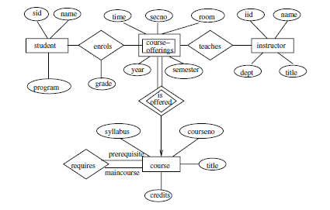

Slide 19
Consider a university database for the scheduling of classrooms for final exams.
This database could be modeled as the single entity set exam, with attributes course-name, section-number, room-number, and time.
Alternatively, one or more additional entity sets could be modeled, along with relationship sets to replace some of the attributes of the exam entity set, as course with attributes name, department, and c-number
section with attributes s-number and enrollment, and dependent as a weak entity set on course room with attributes r-number, capacity, and building
a. Show an E-R diagram illustrating the use of all three additional entity sets listed.

Slide 20
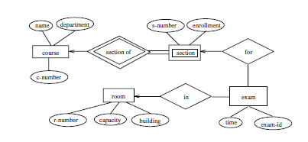

Slide 21
University registrar’s tables:
student (student-id, name, program)
course (courseno, title, syllabus, credits)
course-offering (courseno, secno, year, semester, time, room)
instructor (instructor-id, name, dept, title)
enrolls (student-id, courseno, secno, semester, year, grade)
teaches (courseno, secno, semester, year, instructor-id)

Slide 22
Construct an E-R diagram for a car-insurance company whose customers own one or more cars each. Each car has associated with it zero to any number of recorded accidents.

Slide 23
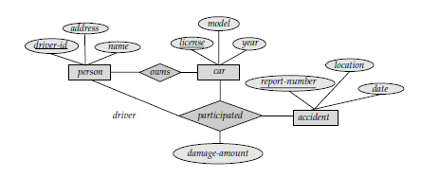
1
m
1
0..*

Slide 24
person (driver-id, name, address)
car (license, year, model)
accident (report-number, date, location)
participated(driver-id, license, report-number, damage-amount)

Slide 25
Construct an E-R diagram for a hospital with a set of patients and a set of medical doctors. Associate with each patient a log of the various tests and examinations conducted.

Slide 26
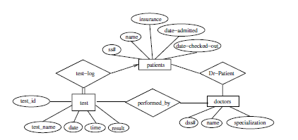

Slide 27
Hospital tables:
patients (patient-id, name, insurance, date-admitted, date-checked-out)
doctors (doctor-id, name, specialization)
test (testid, testname, date, time, result)
doctor-patient (patient-id, doctor-id)
test-log (testid, patient-id)
performed-by (testid, doctor-id)

Slide 28
Explain the difference between a weak and a strong entity set.
Answer: A strong entity set has a primary key. All tuples in the set are distinguishable by that key. A weak entity set has no primary key unless attributes of the strong entity set on which it depends are included.

Slide 29
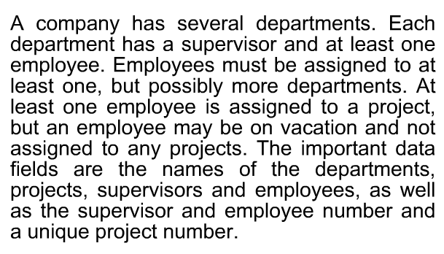

Slide 30
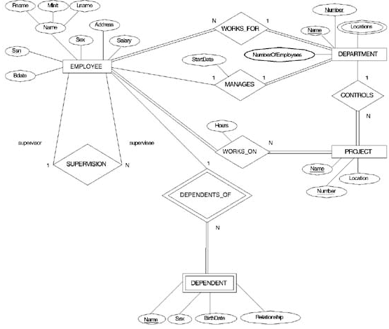
ER DIAGRAM – Entity Types are: EMPLOYEE, DEPARTMENT, PROJECT, DEPENDENT

Slide 31
Designing an ER Diagram
Consider the following set of requirements for a University database. Design an ER diagram for this application:
The university keeps track of each student's name, student number, social security number, current address and phone number, permanent address and phone number, birthdate, sex, class (freshman, graduate), major department, minor department (if any), degree program (B.A., B.S., ... Ph.D.). Some user applications need to refer to the city, state, and zip code of the student's permanent address and to the student's last name. Both social security number and student number are unique for each student. All students will have at least a major department.
Each department is described by a name, department code, office number, office phone, and college. Both the name and code have unique values for each department.
Each course has a course name, description, course number, number of credits, level and offering department. The course number is unique for each course.
Each section has an instructor, semester, year, course, and section number. The section number distinguishes sections of the same course that are taught during the same semester/year; its value is an integer (1, 2, 3, ... up to the number of sections taught during each semester).
A grade report must be generated for each student that lists the section, letter grade, and numeric grade (0,1,2,3, or 4) for each student and calculates his or her average GPA.

Slide 32
University ER Diagram
Degree
Minor In
DName
DCode
OfficeNumber
Name
StudentID
SSN
Birth date
Department
OfficePhone
Sex
Student
Major In
College
Class
Address
Offer
City
State
Zip
Grade_Report
CName
CourseDesc
Letter Grade
Instructor
Year
Course
GPA
CNumber
Belong_To
Credits
Numeric Grade
Section
SectionNumber
Semester

Slide 33
Data Dictionary
The data dictionary is a reference work of data about data (that is, metadata), one that is compiled by systems analysts to guide them through analysis and design.
As a document, the data dictionary collects and coordinates specific data terms, and it confirms what each term means to different people in the organization.
Data flow diagrams are an excellent starting point for collecting data dictionary entries.

Slide 34
Data Dictionary
Systems analysts must be aware of and catalogue different terms that refers to the same data item. This awareness helps them:
avoid duplication of effort,
allows better communication between organizational departments sharing a database, and
makes maintenance more straightforward.
The data dictionary can also serve as a consistent standard of data elements
They may be created after data-flow diagram has been completed, or they may be constructed as the data-flow diagram is being developed.

Slide 35
Data Dictionary
Timefile Record
5.3
Produce
Employee
Paycheck
Employee Paycheck
D2 Employee Timefile
Employee
Employee Record
D1 Employee Master
Date Flow Diagram
Employee = Employee Number +
Record Personal information+
Wage information +
Current pay information+
Timefile = Employee Number +
Record Employee Name +
Hours worked
Employee = Employee Number +
Paycheck Employee Name +
Address+
Current Pay Amounts
Data Structure

Slide 36
Synchronization of System Models
Data and process models represent different views of the same system
These views are interrelated
Thus, modelers need to synchronize the different views to ensure consistency and the completeness of the total system specification.
Synchronization is the process of maintaining consistency between the different types of models

Slide 37
Method of describing the process
Structured English
Decision tree
Decision Table
Example:
A Process that has to determine whether
a customer is to be given credit

Slide 38
Structured English
Structured English is used to
Explain the conditions which occurs in a process.
Identify the decisions which makes these conditions occur.
Find alternative actions to be taken.

Slide 39
Developing Structure Statements
The process is defined by using three types of statements
Sequence structure
Decision structure
Iteration structure

Slide 40
Using Structured English
IF credit limit exceeded
THEN
IF Customer has bad payment history
THEN refuse credit
ELSE
IF purchase above Rs.1000/=
THEN refuse credit
ELSE refer to manager
ELSE
allow credit

Slide 41
Decision Tree
A decision tree can help you examine all possible options when faced with a hard choice or decision.

Slide 42
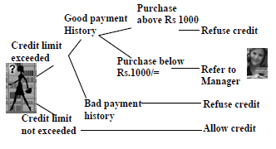
Using Decision Tree

Slide 43
Decision table
A decision table lists causes and effects in a matrix. Each column represents a unique combination.
Cause = condition
effect = action = expected results
If all causes are simply Y/N values: Number of combinations =2^{number of causes}

Slide 44
Steps to Create a decision table
List all causes (conditions) in the decision table
Calculate the number of possible combinations
Fill columns with all possible combinations
Reduce test combinations
Check covered combinations

Slide 45
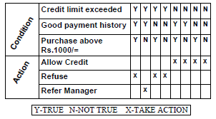
Using Decision Table

Slide 46
Structured English
IF credit limit exceeded
THEN
IF customer has bad payment history
THEN refuse credit
ELSE
IF purchase above Rs. 1000/=
THEN refuse credit
ELSE refer to manager
ELSE allow credit

Slide 47
Structured English used to
Explain the conditions which occurs in a process.
Identify the decisions which makes these conditions occur.
Find alternative actions to be taken
The process is defined by using three types of statements
Sequence structure
Decision structure
Iteration structure

Slide 48
System design Approaches
Modern structured design
Information engineering
Prototyping
JAD
RAD
Object-oriented

